Slide 1
Engineering Services RFP
Pre-Proposal Conference
August 6, 2026
Ramsey/Washington Recycling & Energy
Notes:
Jim

Slide 2
Welcome
Agenda
Overview of Ramsey/Washington Recycling & Energy
Overview of engineering services scopes of work
RFP process and information
Q&A after presentation
Note: Verbal statements (including during this pre-proposal conference) shall not be relied upon to be terms of the RFP documents. All modifications to RFP documents shall be in writing.
RFP Authorized Representative: James Redmond jredmond@recyclingandenergy.org
Notes:
Jim

Slide 3
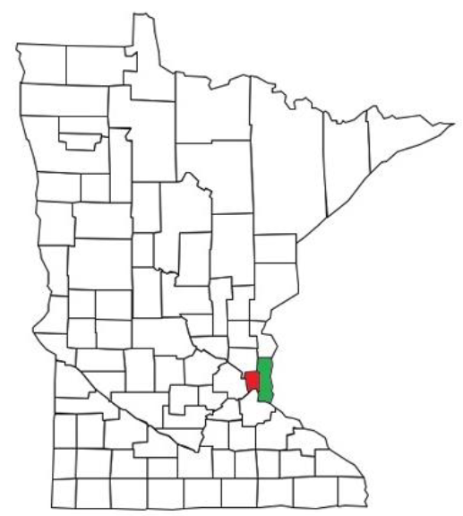
Ramsey & Washington Counties, MN
Two counties in the eastern part of the seven-county Minneapolis-St. Paul metropolitan area
Over 810,000 residents and 28,000 businesses
  14% of the population of Minnesota
Consists of urban, suburban and rural areas
Racially diverse, many languages spoken
In Minnesota, counties are the unit of government responsible for the management of solid waste and implementing programs (recycling, composting, hazardous waste disposal, etc.)
Notes:
Trista

Slide 4
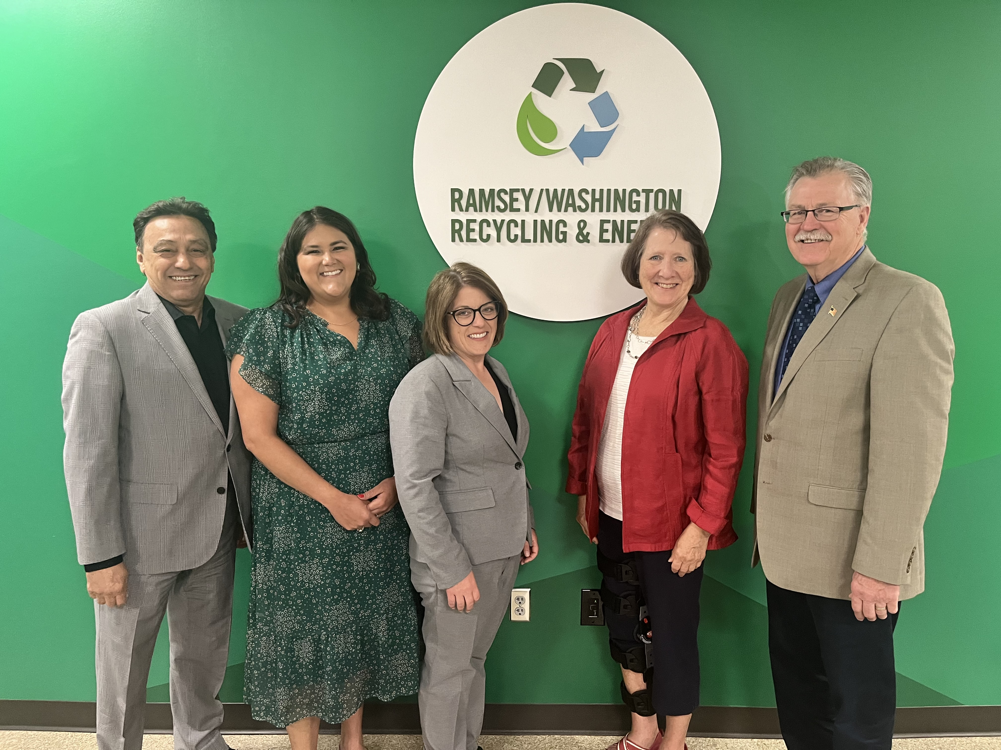
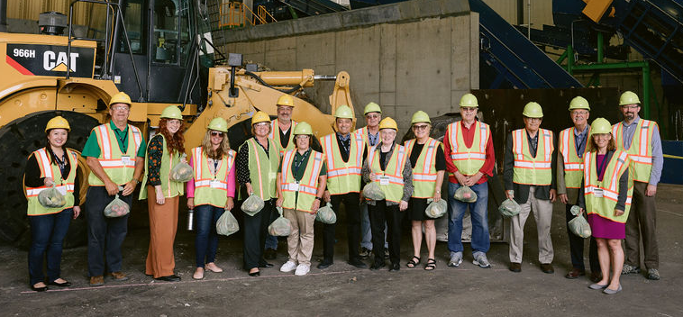
Recycling & Energy Board
Joint powers board
Three Ramsey County and two Washington County commissioners
Own and operate a waste processing facility in Newport, MN, the Recycling & Energy Center (R&E Center)
Board-directed programs and efforts are completed by R&E staff, working closely with staff from each county's public health department
Notes:
Trista

Slide 5
R&E Board Guiding Statements
R&E Vision
Vibrant, healthy communities without waste
R&E Mission
Enhancing public health and the environment by creating value from waste through partnerships
R&E Board Principles
Plan for a 20- to 30-year horizon ​
Assure flexibility
Manage risk ​
Pivot the view from “waste” to “resources” to add value to the local economy and environment​
Move resources up the waste hierarchy
Notes:
Trista

Slide 6
Engineering Work at R&E
In the transition from private to public ownership of the R&E Center, consultant engineering services were key
Today, R&E utilizes outside engineering support to address a wide variety of needs, such as:
  Equipment, operations and construction monitoring
  Insights on emerging technologies
  Strategic plan implementation
  Commitments & compliance
  Policy development and planning
  Data gathering, management, analysis and visualization
Notes:
Jim

Slide 7
Engineering Services RFP
Engineering services are broken down into two categories:
General engineering services, including strategic and programmatic efforts
Engineering services specific to the R&E Center
Respondents may submit a proposal for one or both areas
  Team responses are also allowed
  R&E may award one contract for both areas or two separate contracts
Notes:
Jim

Slide 8
2025-2030 Strategic Imperatives & Goals
Develop, Grow and Sustain Relationships
Public awareness and trust
R&E-led coordination on policy and plans
Innovate for Impact
Equitable participation and increased public engagement
Advance Circularity: Transform Waste into Resources
Enhance Organizational Efficiency, Resilience and Accountability
Minimal food landfilled
GHG emission reduction to address climate change
Prioritized waste reduction and diversion
Increased end market
Hub-and-spoke resource recovery system capacity
Strengthened governance and maximized nimbleness
Streamlined internal processes, capacity-building
Robust obligation tracking and reporting
Readiness to pursue next opportunities
Notes:
Leigh

Slide 9
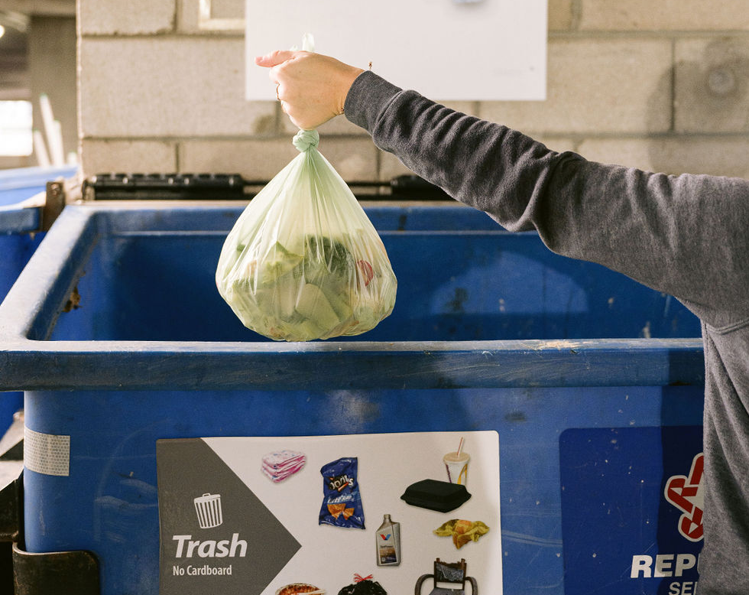
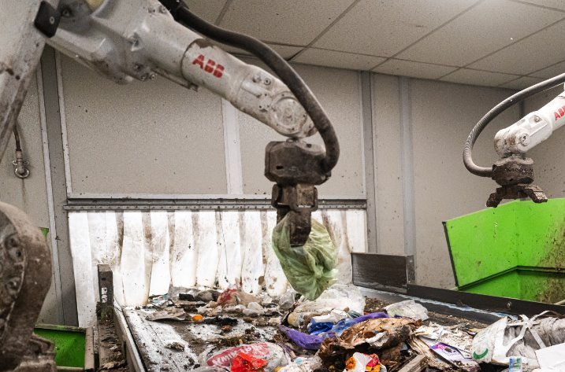
Food Scraps Pickup Program
Food scrap recycling made easy, accessible, and free!
Residents collect all food scraps and compostable products in program-provided food scrap bags
Put the bags directly into trash bin/dumpster
Trash haulers pick up the trash with food scrap bags in it; food scrap bags are sorted out using robots
The sorted bags get sent to an industrial compost facility (future: anaerobic digester)
Examples of Engineering Services that support FSPP:
Bag manufacturing spec. testing | In-bag waste composition studies
Program participation studies | Hauler outreach/engagement
GIS support for internal dashboarding and program eligibility
Strategic planning | Research and data analysis
Notes:
Leigh or Hanson

Slide 10
Scope: Strategic & Programmatic Efforts
Solid waste management research and evaluation
Upstream efforts assistance
  Food Scraps Pickup Program
  Moving materials up the waste hierarchy
  Communication, facilitation, education and engagement
Future technology
  Solid waste/materials processing, sorting technologies
  Sustainable material marketing and end-uses
Policy and planning
  R&E Strategic Plan and County Solid Waste Management Plans
  Meeting metro and state requirements and goals
  Extended producer responsibility (EPR)
  Regional governance frameworks
Notes:
Leigh

Slide 11
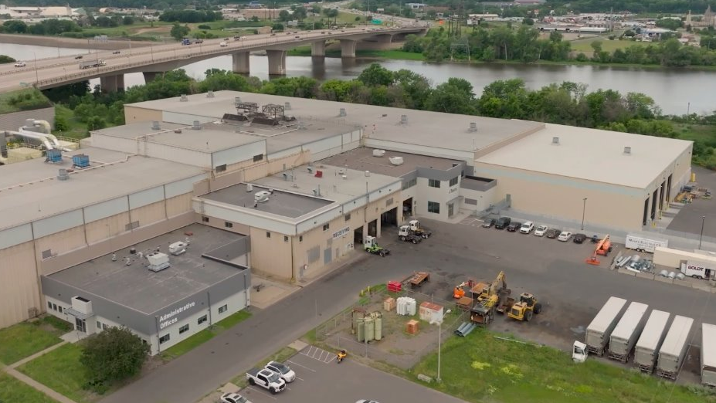
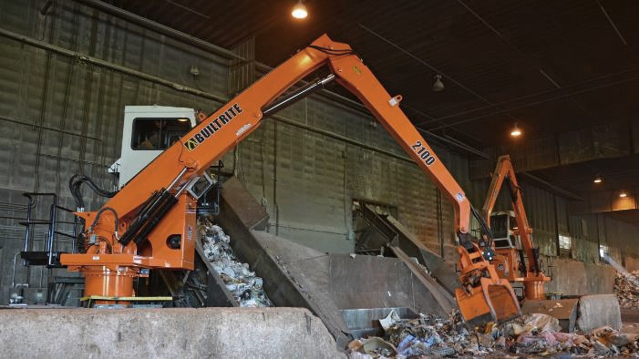
The R&E Center
Purchased by the counties in 2015
Receives all of the two counties’ residential and commercial MSW
Produces refuse-derived fuel (RDF) used by Xcel Energy to generate electricity
In 2025, the R&E Center:
  Managed 432,862 tons of MSW
  Recovered 11,091 tons of metals from the trash
R&E has invested in enhancing this facility to capture more value from waste and reach MN’s goals for 75% recycling and climate emission reduction
Notes:
Sam Holl

Slide 12
Scope: R&E Center
Odor Control/Monitoring
Waste Delivery & Materials Marketing
  Capacity monitoring
  Data management
  Procurement assistance
  Sale of materials from R&E Center production
Operational Assistance
  Processing equipment & construction assistance/oversight
  Permitting and reporting
  Metro green energy campus
Notes:
Sam Holl

Slide 13
RFP Evaluation
All required items must be included in the response (See Section 3, Proposal Content, page 6-7)
Proposers will be ranked based on responses
Evaluation considerations will include qualifications, demonstrated understanding and approach, cost, references, and any additional relevant information
Selected proposers may be chosen for interviews
Notes:
Jim

Slide 14
Overall Timeline
Q&A Addendum Published
August 20, 2026
Proposal Due Date
September 6 September 9, 2026, at 4:00 pm Central Time
Contract Term
3 years with option of two 1-year renewals
Commencement Date
Anticipated
Between mid-Nov. 2026 and Jan. 1, 2027
Notification of Award
Anticipated
October 9, 2026
Notes:
Jim

Slide 15
Next Steps
Notify Jim Redmond if you wish to be added to the email distribution list about this RFP.
Next Steps
  Send questions to jredmond@recyclingandenergy.org by Aug. 13
      Questions received after August 13 may not be answered
  All clarifications and RFP revisions will be documented via addenda and published to R&E’s website www.recyclingandenergy.org/vendors
Proposals due Sunday, Sep. 6, 2026 Wednesday, Sep. 9, 2026
Sent electronically via email – Section 4 of RFP
Notes:
Jim

Slide 16
Question & Answer
Verbal statements (including during this pre-proposal conference) shall not be relied upon to be terms of the RFP documents. All modifications to RFP documents shall be in writing.
Notes:
Jim

